Slide 1


Slide 2


Slide 3
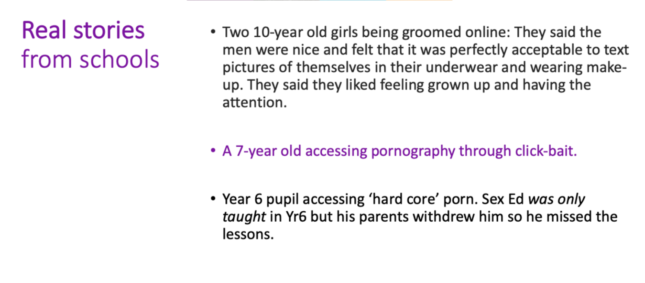

Slide 4
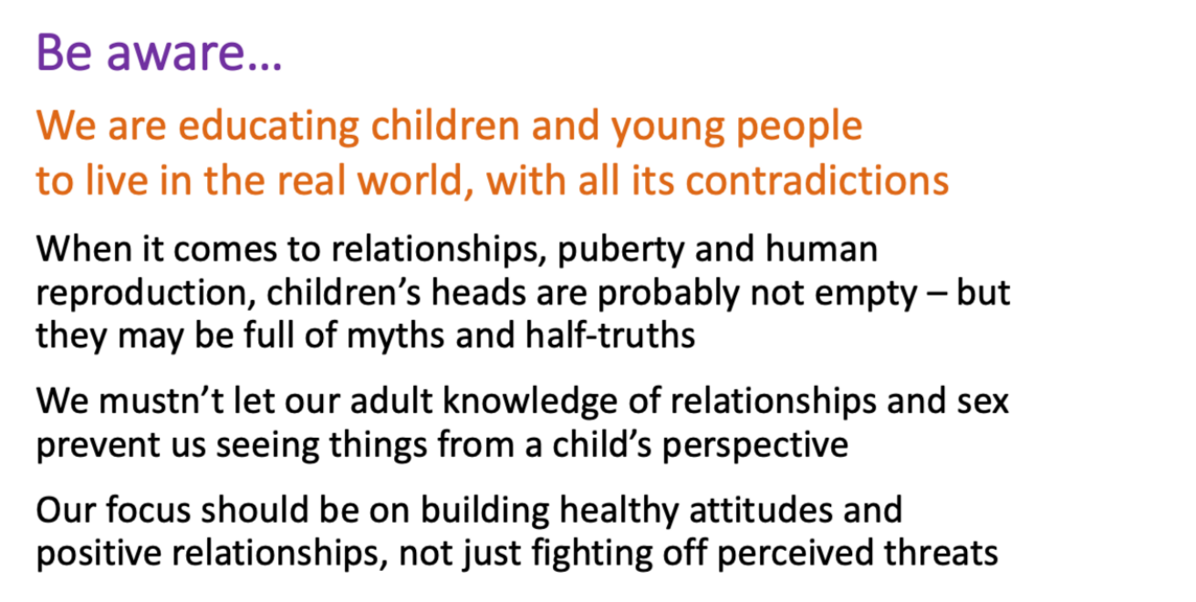

Slide 5
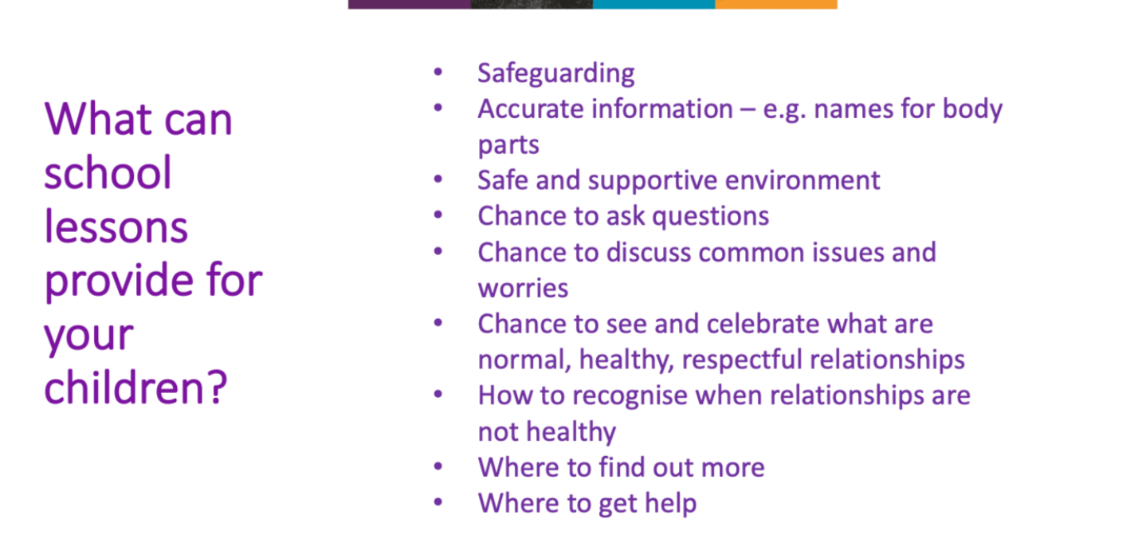

Slide 6


Slide 7


Slide 8
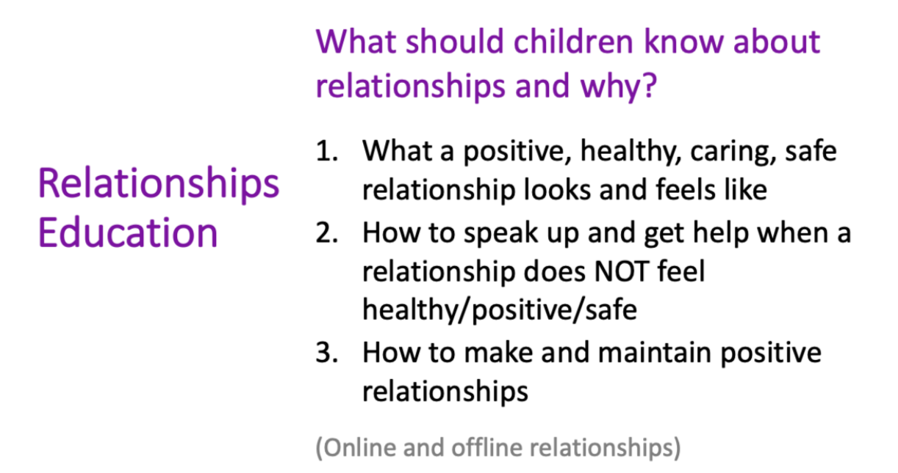

Slide 9
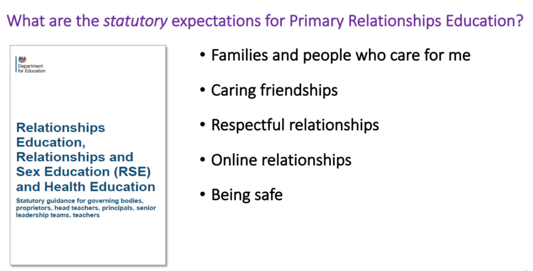

Slide 10


Slide 11
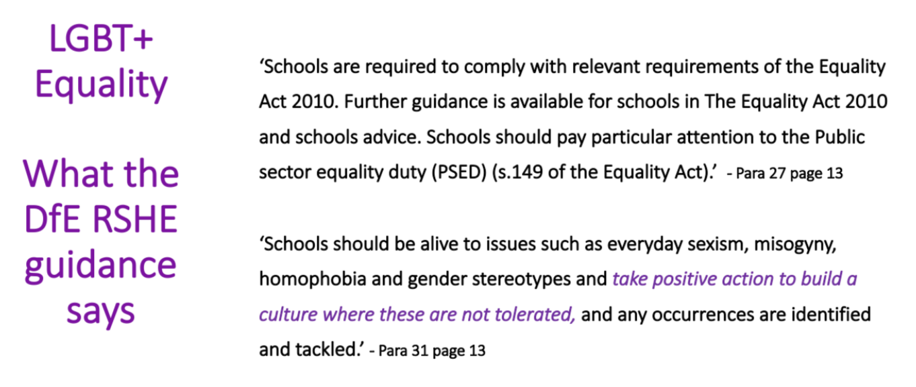

Slide 12
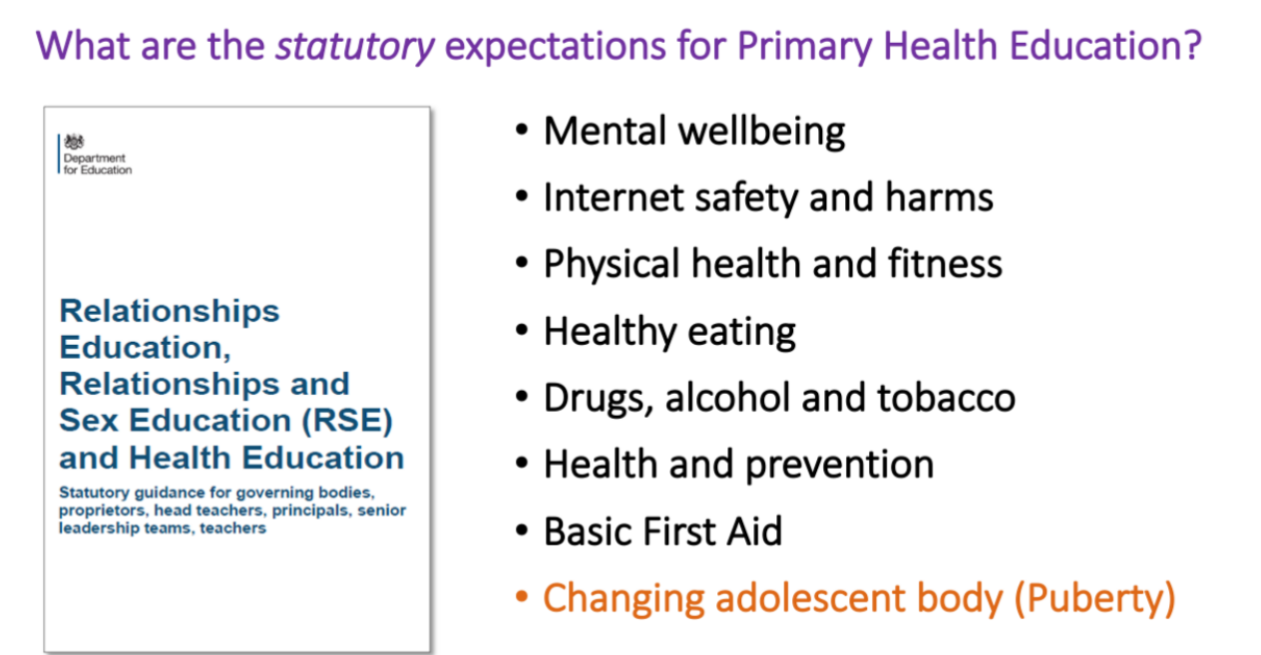

Slide 13
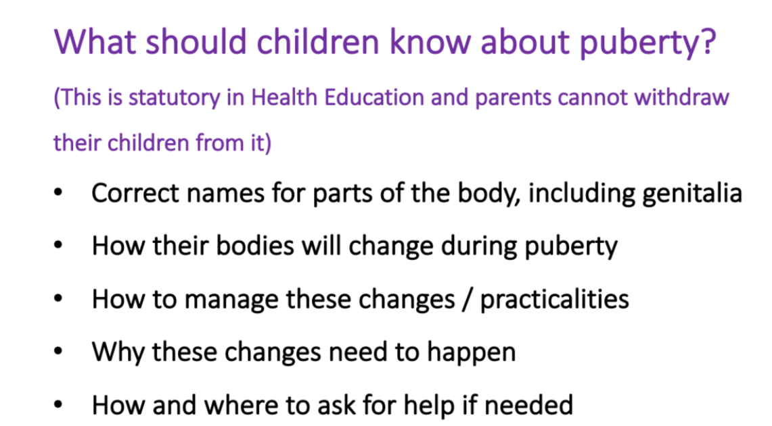

Slide 14
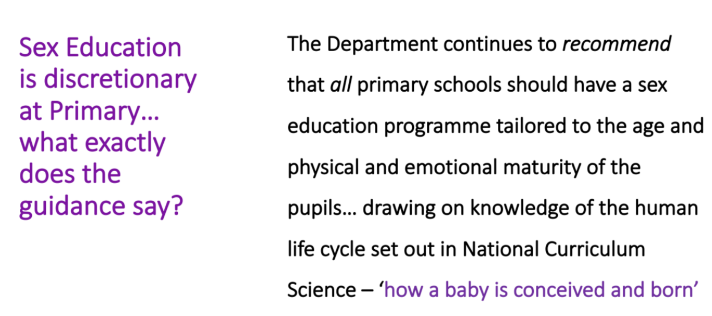

Slide 15
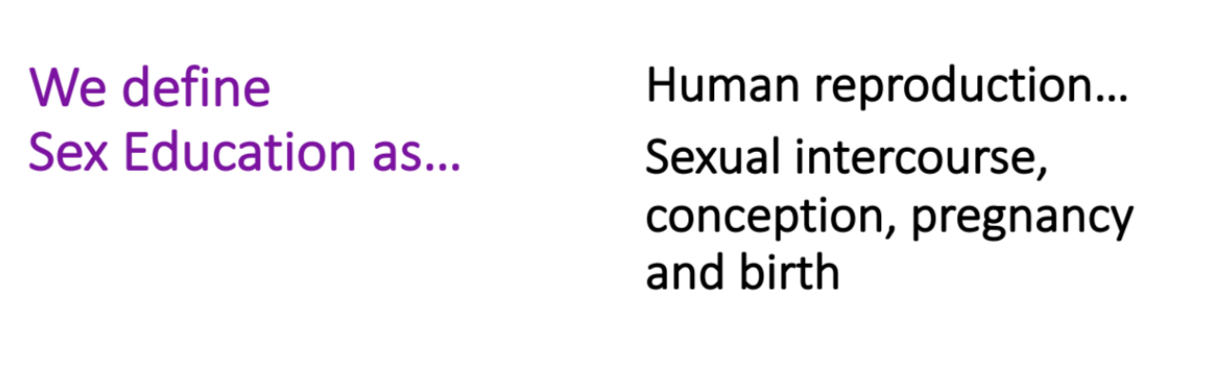

Slide 16
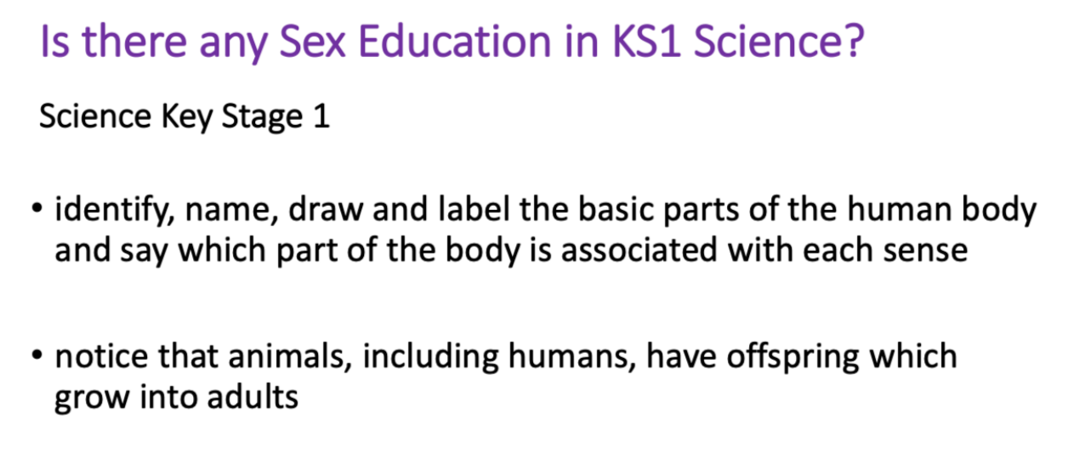

Slide 17
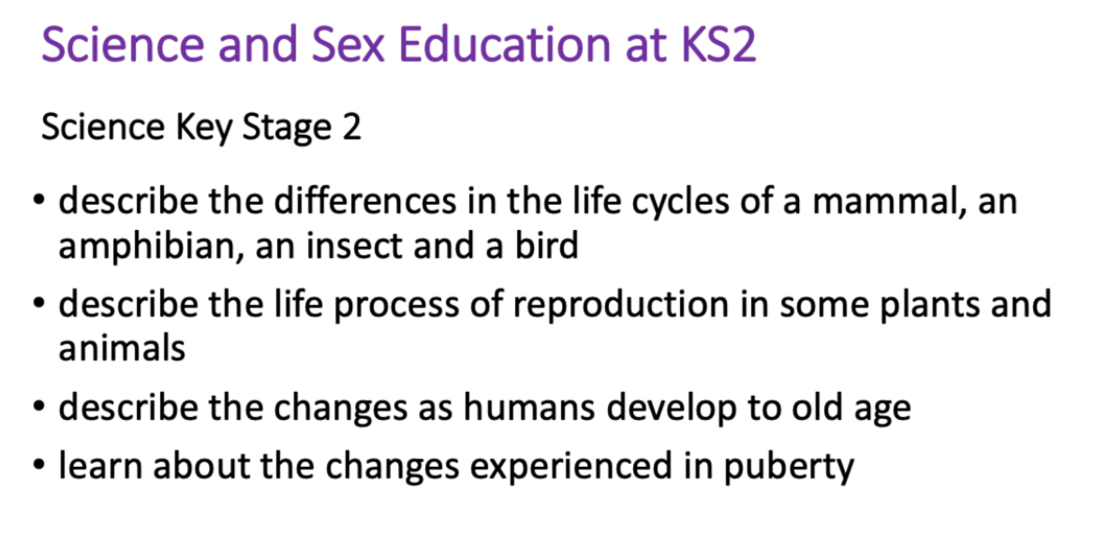

Slide 18
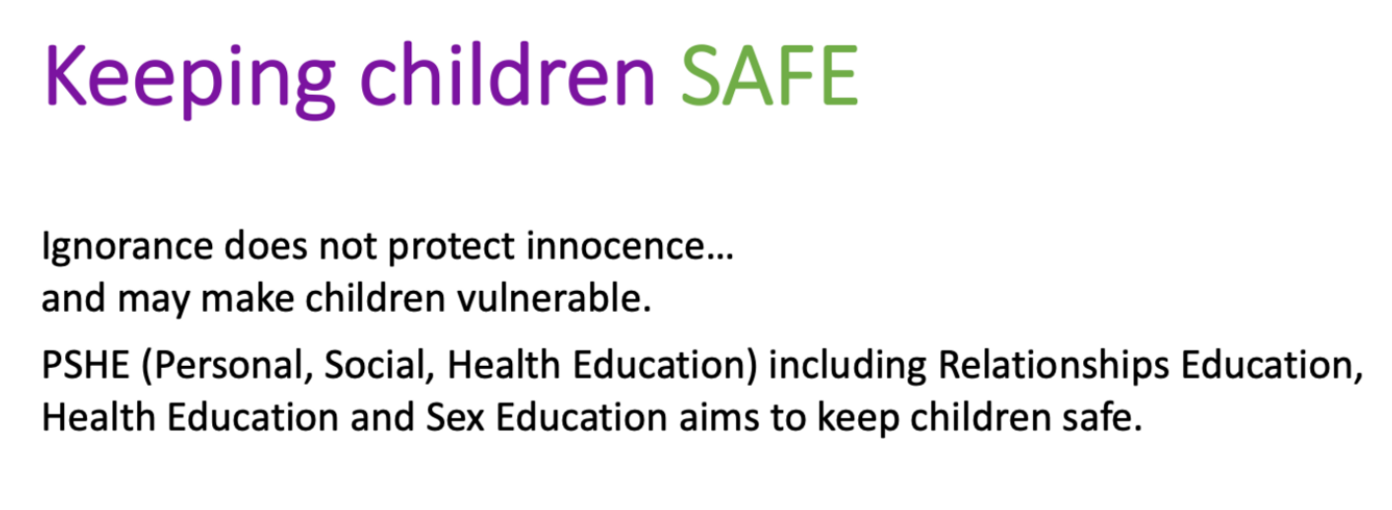

Slide 19
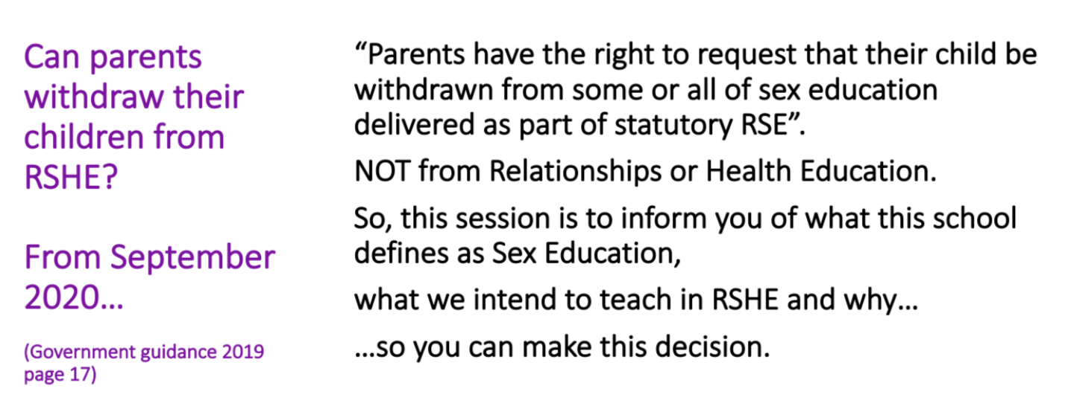

Slide 20
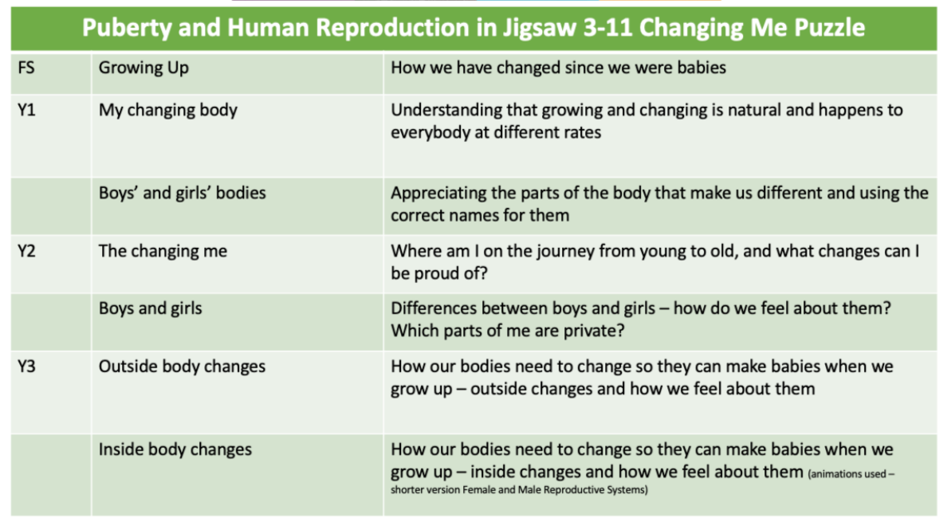

Slide 21
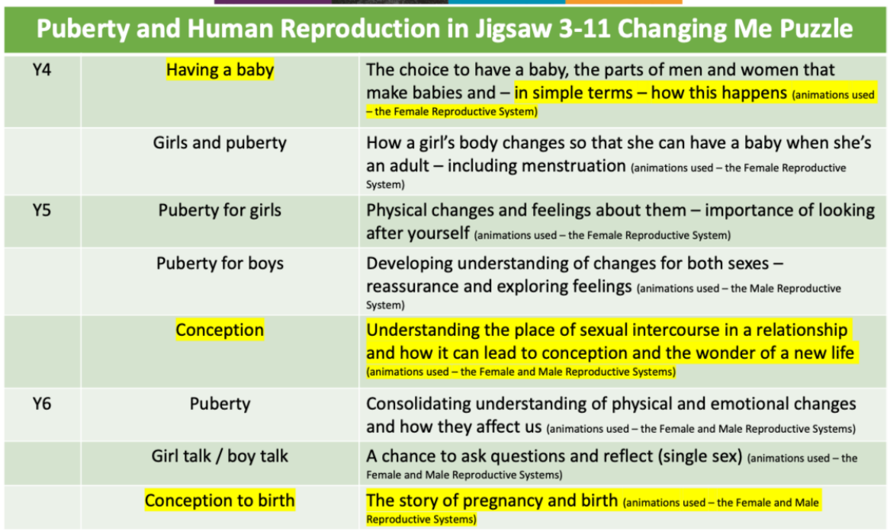

Slide 22
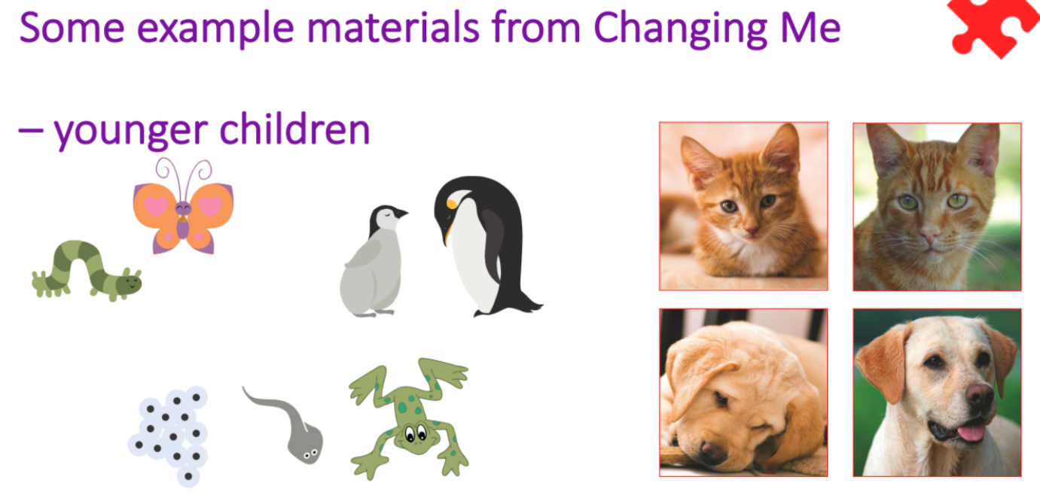

Slide 23
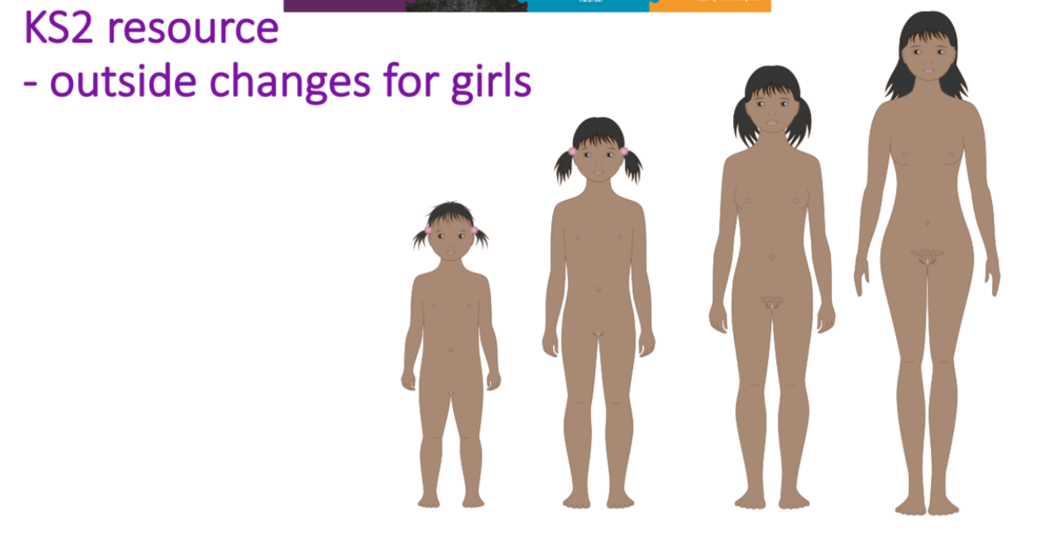

Slide 24
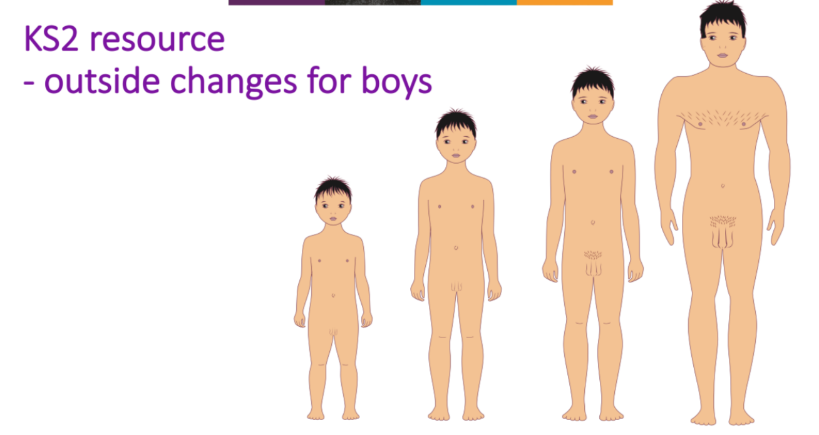

Slide 25
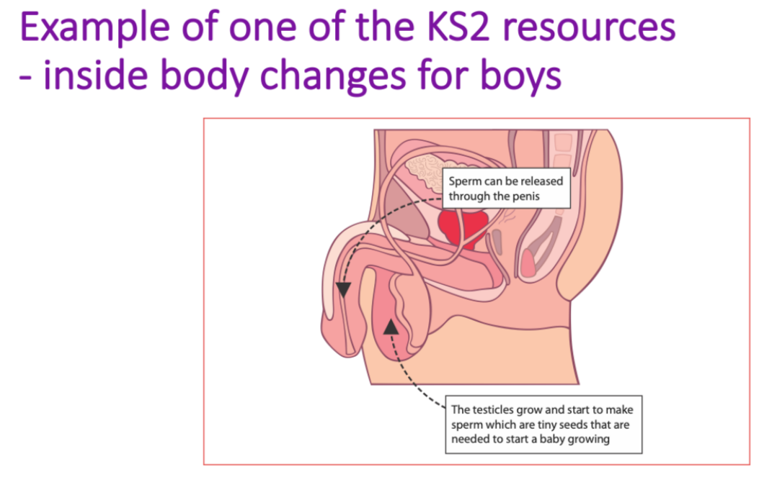

Slide 26
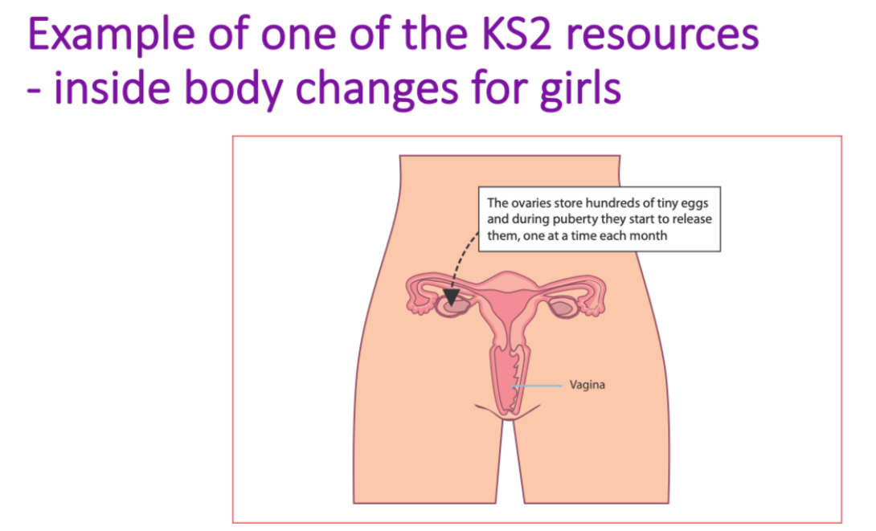

Slide 27
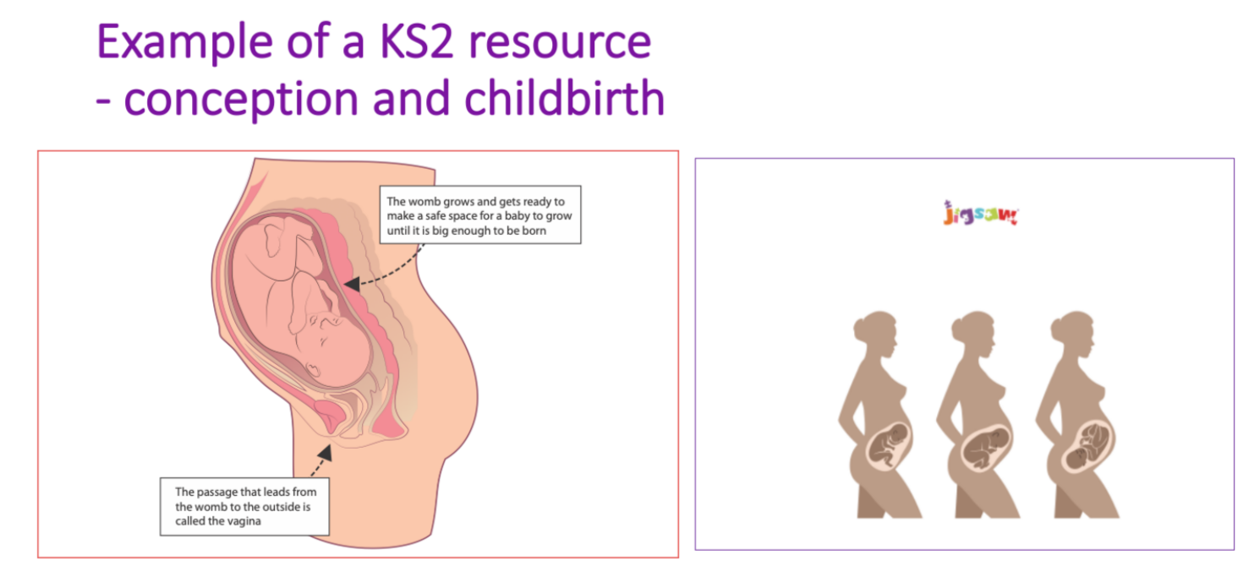

Slide 28
Recommended texts to support your child’s understanding of sex education
Where Willy Went : Allan, Nicholas: Amazon.co.uk: Books
Mummy Laid An Egg! : Cole, Babette: Amazon.co.uk: Books
Hair In Funny Places : Cole, Babette: Amazon.co.uk: Books
What's Happening to Me? (Girls Edition) (Facts of Life): Amazon.co.uk: Meredith, Susan, Leschnikoff, Nancy: 9780746069950: Books
Grow Up and Love Your Body!: The Complete Girls’ Guide to Growing Up Age 8-12 incl. Body-Care and Self-Esteem Special : Weston, Sarah P.: Amazon.co.uk: Books

