Slide 1


Manor Adventure
WEDS 17th – FRI 19th June 2026

Slide 2

Manor Adventure – Culmington Manor
Culmington Manor offers exceptional facilities within a 100 acre estate in an area of outstanding natural beauty in the South Shropshire countryside. The superb estate is located close to the Welsh borders and nine miles from the historical town of Ludlow. The grounds consist of woodlands, fields, and gardens inhabited by an abundance of wildlife.
Hidden away in the Corvedale Valley, the estate provides a safe and secure environment for schools to enjoy outdoor pursuits. The centre operates within a very compact central area with the majority of activities taking place within 15 acres surrounded by the various accommodation options.
https://www.manoradventure.com/culmington-manor.php

Slide 3
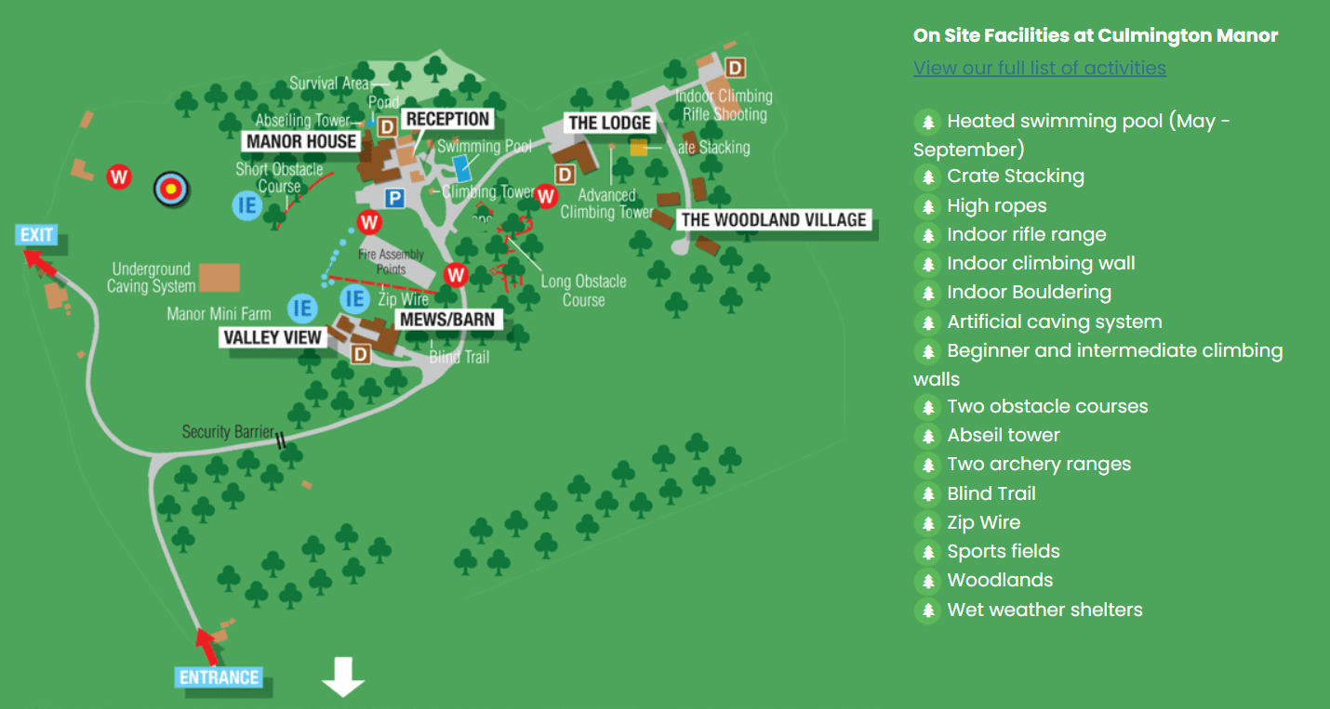

Slide 4
Timings:
Leave school at 1pm (approx.) on Wednesday 17th
Arrive at Manor Adventure at 2.30pm
Leave Manor Adventure at 1.30pm on Friday 19th
Arrive back at school by 3pm
(ready for normal collection time)

Slide 5



Amazing activities will we take part in:
Abseiling
Aero-ball
Climbing
Evening Walk
Zipwire
Low ropes
Obstacle course
Axe- throwing
Grass Sledge

Slide 6
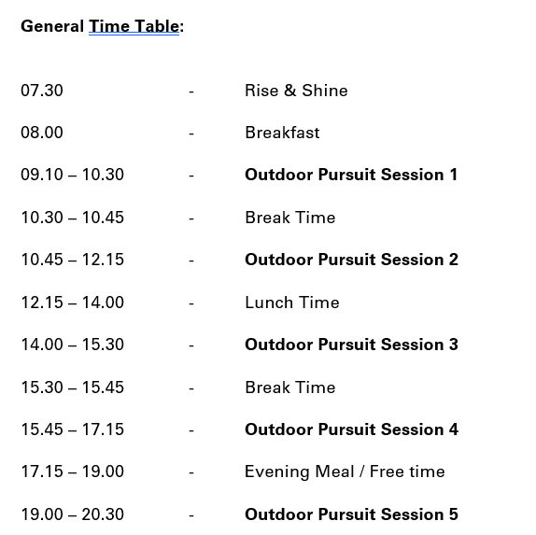
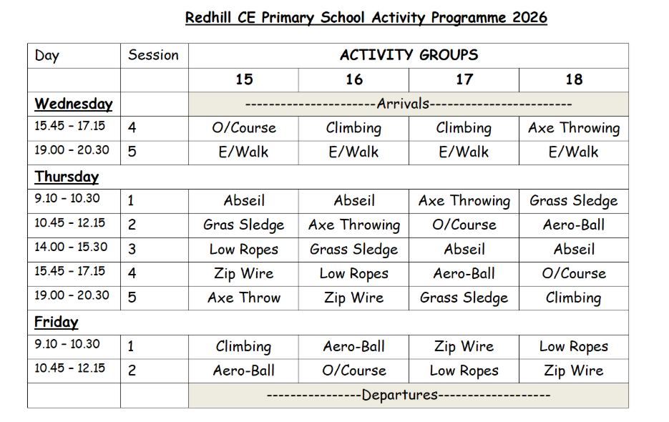

Slide 7
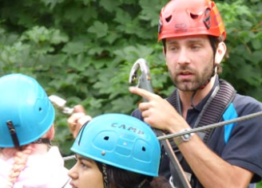
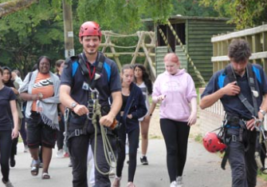
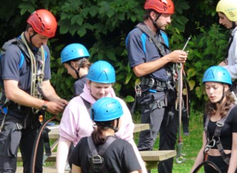
Children will be in activity groups of 12. These groups will remain the same throughout the trip. Each group will be led by qualified instructors at Manor Adventure, with Red Hill school staff supporting.

Slide 8
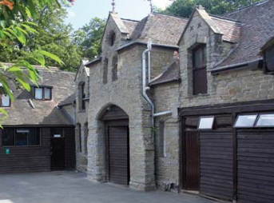
Sleeping arrangements:
We will be staying in ‘The Mews’ and children will be sleeping in groups of 6-12. All children will be with a friend that they have chosen in boy or girl rooms. Each room has its own bathroom with toilet, sink and shower.
We stayed in this accommodation last year and it worked brilliantly, as we have a private courtyard the children can play in during free time.

Slide 9
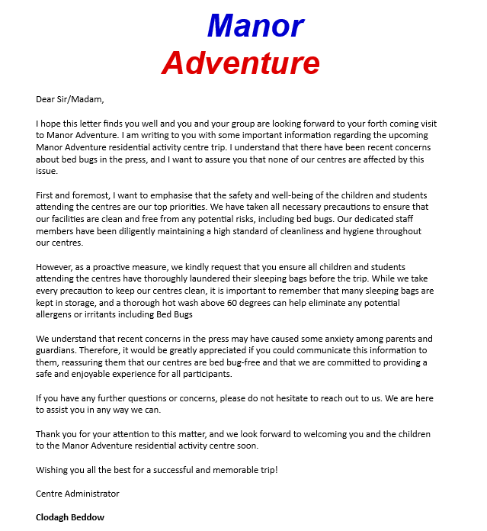

Slide 10
Recommended kit list:
-One suitcase per child
Clothing
-OLD clothes (ALL labelled!) Long sleeved shirts/jumpers, trousers/jogging bottoms (no denim), T-shirts, shorts, underwear
-Closed toe shoes e.g trainers, NO wellies
-Underwear and socks
-Waterproof jacket
-PJs and slippers
Other
-Sleeping bag and pillow with pillowcase
-Refillable drinks bottle
-A torch
-Small rucksack/school bag for walk
-Toiletries e.g. shampoo, body wash (only roll on deodorant)
-Bath towels x 2
-Sunglasses, suncream, hat
-Black bin liner for dirty clothes
-Book, playing cards etc NO electronics or phones
-Money for snacks (Maximum £5) *Children must NOT bring any NUT products, due to allergies in the group

Slide 11
Medications and Support
Medication: Medication forms available to fill in today. Medication drop off at school on Monday June 15th at 8.30am, in the RAP room. Please drop off all medication and paperwork at this time only. School inhalers and Calpol will be taken. If your child requires travel sickness tablets, please ensure you send enough for the journey there and back.
Additional needs: If your child requires any additional support during this trip, please arrange to speak with Mr Sparkes, Mrs Tomkinson or Mrs Gardner directly, so we can ensure that are supported as needed e.g. bedtime / toileting etc

Slide 12
Facebook and Permissions
During the trip, we will post updates via our school Facebook page – this will include photos of the children taking part in the activities.
If your child does not have Facebook permission, we will ensure they are not included in the photos posted.
If you would like to change permissions for this trip only (allow your child to be photographed so you can see them on updates), please let Mrs Tomkinson know.

Slide 13
Questions:
Can my child bring a teddy? Absolutely yes!
Can my child bring some sweets and snacks? One bag each (NO NUTS due to allergies)
What if my child gets sick or injured while away? We will contact you if there are any issues.
Can my child contact me during the trip? No. We will contact you if needed.
Will the school update us during the trip? Yes, we will add photos to the school Facebook page.
Who do I contact in case of emergency? Please contact school as normal during the day and they will get in touch with us. Out of school hours, you can email Mr Sparkes, Mrs Tomkinson or Mrs Gardner, or alternatively call Manor Adventure directly on 01584 861333.
Does my child need any money for this trip? They are able to bring a maximum of £5 for snacks and souvenirs.
Any further questions?

