Slide 1

Meet the teacher – Reception 2025

Slide 2
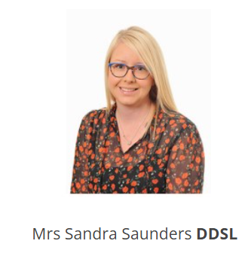
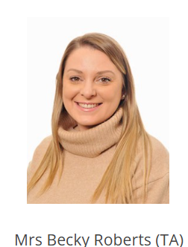
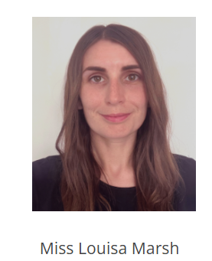
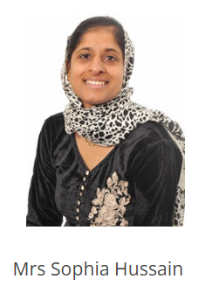
Meet the team in RSS

Slide 3
Punctual 8:40 – 8:50 am drop off – morning activities
• 3:25pm collection – please notify us of change to collection
• Organisation - lunchbox (unless school lunch)
- book bags away
- snack for breaktime (labelled)
- coats and jumpers (labelled)
- water bottle (labelled)

Slide 4
Please ensure your child comes to school in their PE kit every Wednesday. They will remain in their kit for the whole day. PE days may change each half term, and we will notify you of any updates by email.
Forest School will, begin on Tuesday 16th September. On Forest School days, children should come to school wearing clothes you don’t mind getting a little muddy. They will also need to bring waterproofs in a named bag, with each item clearly labelled. Unfortunately, due to the size of our cloakrooms, waterproofs cannot stay in school.

Slide 5

Overview of topics

Slide 6
We follow the White Rose Maths curriculum but adapt it to best meet the needs of our children. Over the year, we will be learning about
• Place Value
• 2D & 3D Shapes
• Time and Money
• Addition and Subtraction
• Doubling and Halving
• Measurement: Weight, Height, Length and Capacity
• Multiplication and Division (Grouping and Sharing)

Slide 7
At our school, we use the Little Wandle programme to teach phonics and early reading. This helps children build strong foundations in sounding out words, developing fluency, and fostering a love of reading. We adapt the programme to support every child on their reading journey, ensuring they feel confident and enjoy success as readers.
Although your child will be taught to read at school, you can have a huge impact on their reading journey by continuing their practice at home.
There are two types of reading book that your child may bring home:
A reading practice book. This will be at the correct phonic stage for your child. They should be able to read this fluently and independently.
A sharing book. Your child will not be able to read this on their own. This book is for you both to read and enjoy together.
You can learn more on how to support your child at home during our Phonics meeting on Tuesday, 23rd September at 3:35pm,
Books will be given out on Mondays but must be returned on Thursdays.

Slide 8
Important information
Sleep – Please make sure your child has plenty of sleep and eats breakfast in the morning so they are ready to learn at school.
Open Door Policy – We want you to know that we are here to support you as parents whenever you need us. If you would like to speak with us, appointments can be made via email for a phone call. We are always happy to help and support you in any way we can.
Important Messages – If you need to share an important message about your child during the school day, please contact the school office. We may not see emails during school hours, so the office is the best point of contact for urgent matters.
Together, by working in partnership, we can give your child the very best support and help them to thrive at school.

