Slide 1


Slide 2
Welcome to Black Pepper Catering
Just like you we are new here!
This is our first year catering at Red Hill but don’t worry we have over 10 years experience catering for local schools so you are in safe hands with us.
We are cooking on site with some highly experienced chefs so rest assured your little ones will get the best food possible!
We are a small family run company, a father daughter team led by David and his daughter Saffie. Between us we have over 20 years’ experience in the Catering and Customer Service industry.
We have a team of three working in the kitchen here at Red Hill to make sure we can offer the best food possible for your children to ensure they have a smooth day with no grumbling tummy's!

Slide 3
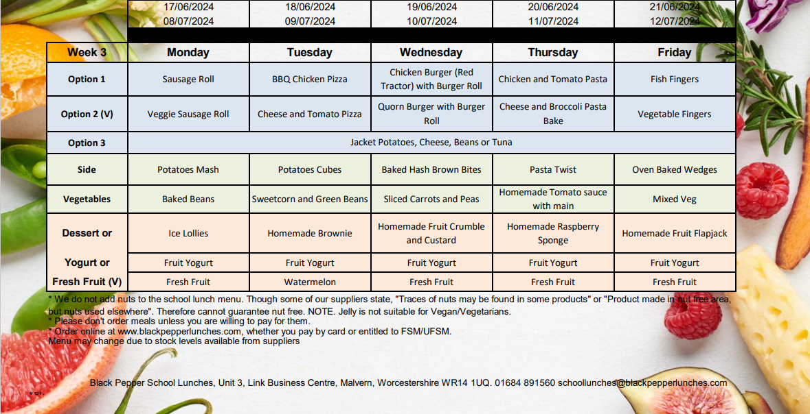
Example of a week of our menu

Slide 4
Registering & Ordering
Every child will need to be registered with us if you would like meals.
You can order online whether you are paying by card or entitled to free school meals. If you need to cancel or edit a meal you can also do this online.
You can order termly, weekly, or daily, with no minimum order, just make sure you order before midnight for the following day.
So how do you order?

Slide 5
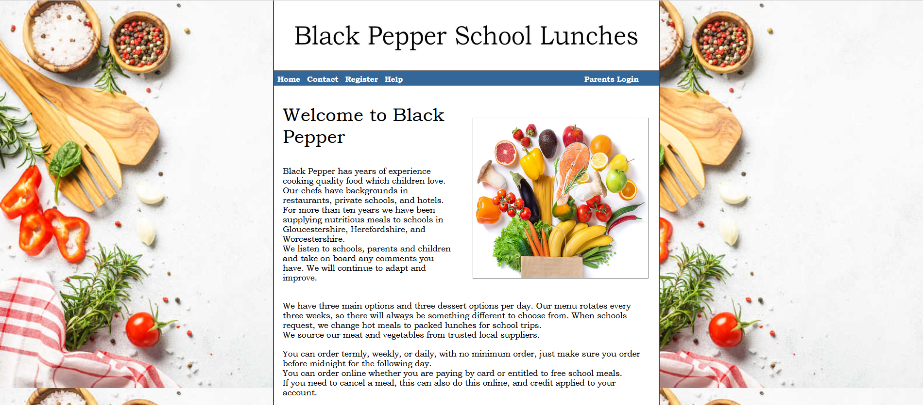
Firstly, go to Black Peppers Homepage
& Click ‘Register’

Slide 6
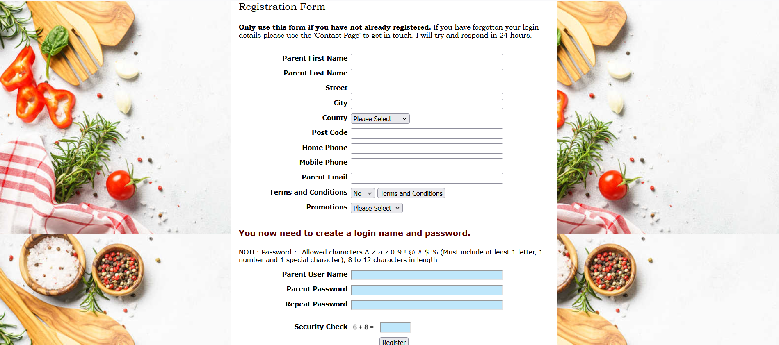
Fill in all your details and
Create a Username and Password

Slide 7
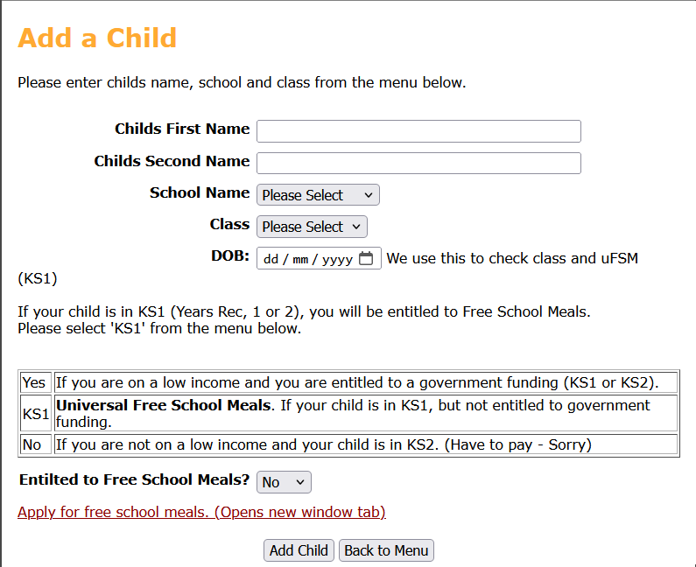
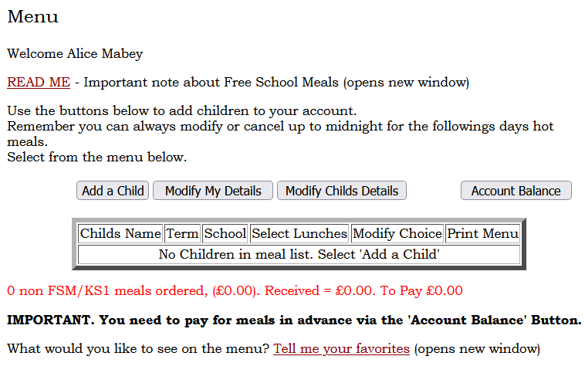
Click ‘Add a Child’ and then fill in their details
(this step can be repeated if you have more than one child)
Please remember to select whether you are entitled to Free School Meals

Slide 8
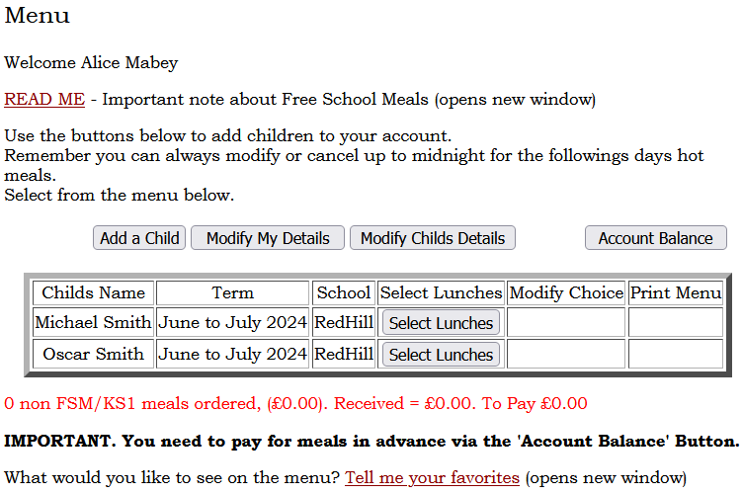
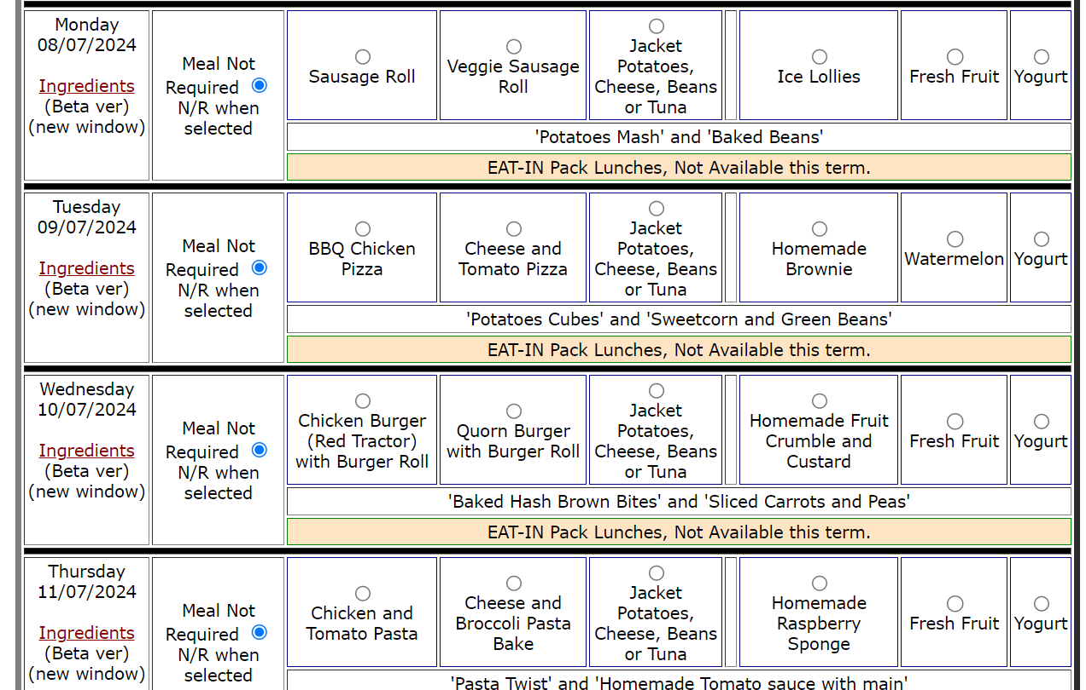
Click ‘Select Lunches’ and then make your choices!
Make sure your click ‘Save Details’

Slide 9
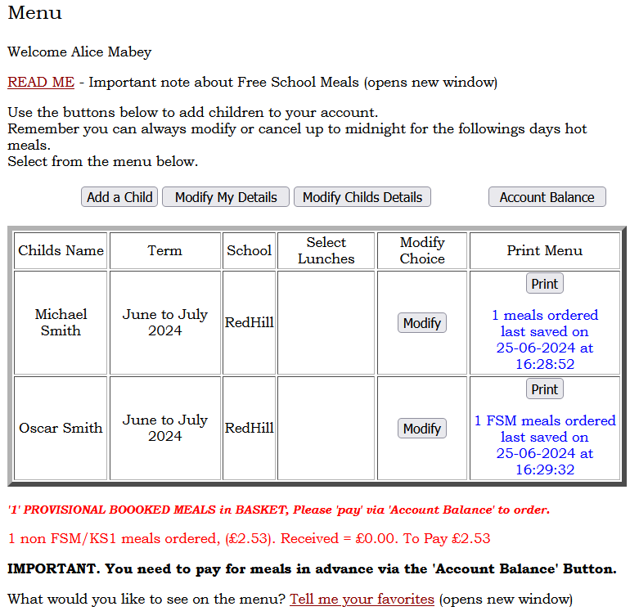
Paying for your meals
You can see the amount you owe at the bottom and then click ‘Account Balance’ and this will take you to the payment page.

Slide 10
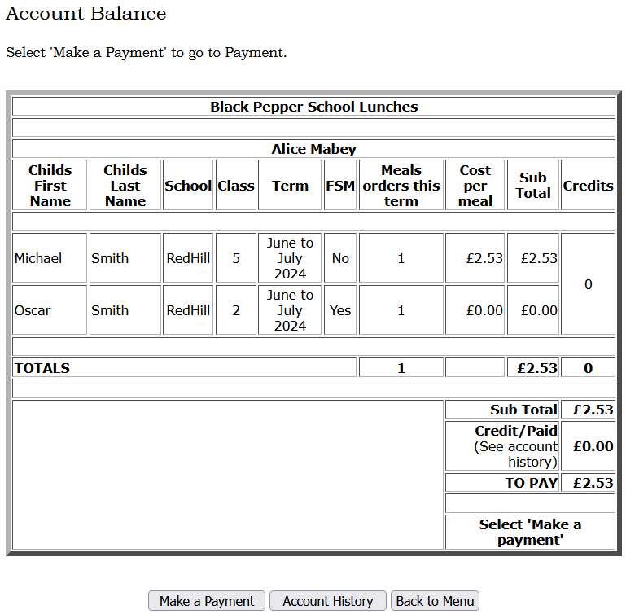
Paying for your meals
Click ‘Make a Payment’
This will then take you to a page to enter your card details. Once that’s completed you are all booked!

Slide 11
Questions
We are here all day so if you have any questions please come and find us. Alternatively, there is a contact us button on the website that comes straight through to us.
Please enjoy the cake samples!
We look forward to cooking for your children.

