Slide 1

Year 1 Phonics Screening

Slide 2
What is phonics?
Children are taught to read by breaking down words into separate sounds or ‘phonemes’. They are then taught how to blend these sounds together to read the whole word.
Children have a 20 minutes phonics lesson each day and they are encouraged to use these strategies to read and write in other lessons.
There are around 42 different sounds.

Slide 3
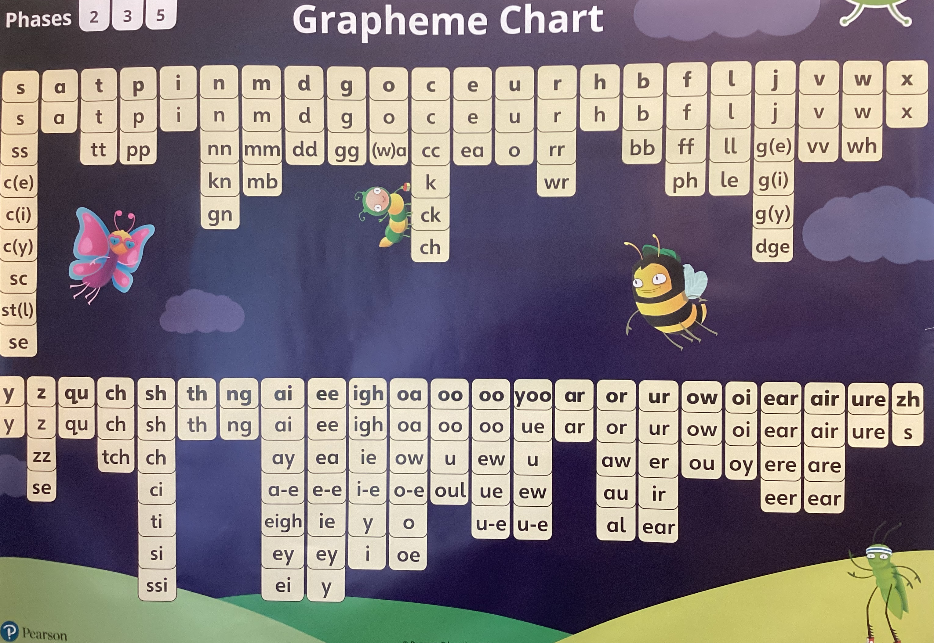

Slide 4

Why the phonics screening check is done
Every Year 1 child in the country will be taking a government set phonics screening check in the same week.
The aim of the check is to ensure that all children are able to read by the end of year two.
This ‘midpoint check’ will ensure that we have a clear understanding of what the children need to learn in year 2.

Slide 5

What will the children be expected to do?
The check is very similar to tasks the children already complete during phonics lessons.
Children will be asked to ‘sound out’ a word and blend the sounds together.eg d-o-g - dog
The focus of the check is to see which sounds the children know and therefore the children will be asked to read made up ‘nonsense’ words.
This is not a reading test.

Slide 6
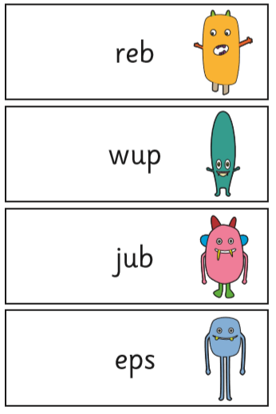
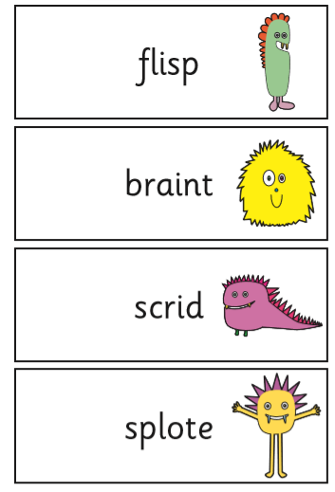
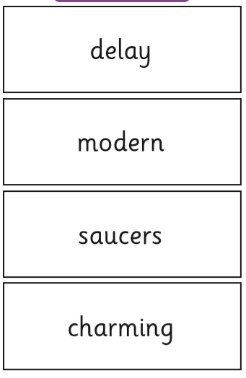
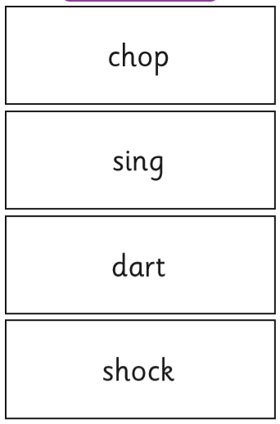
Examples of words

Slide 7
When will the screening check take place?
The screening will take place throughout the week beginning 10th June. It is important your child is in school during this week.
Please do not tell your child they will be doing a phonics check.
The check has been designed so that children of all abilities will be able to take part.

Slide 8
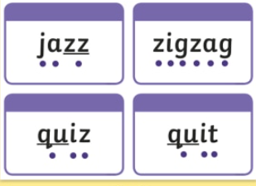
Participating in the screening
The children will complete the check one at a time in a quiet area of the school.
A known adult will conduct all of the screening checks with the children.
The screening will only take 5-10 minutes with each child.
The screening check will consist of 40 words.
We keep the screening low key and the children will be unaware they are taking a screening check.
To support them with reading, children are able to draw their own sound buttons onto the screening to support them. They cannot be instructed to do this though.

Slide 9
Results
The pass mark is not known whilst carrying out the phonics screening check. It isn’t released until later in the year.
The pass mark last year was 32.
We will let you know how your child got on, in their end of year report.
If your child does not meet the threshold this year they will retake the screening check in Year 2. Phonic intervention groups will continue to be in place.

Slide 10
How can you help?
Encourage your child to segment and blend when reading or writing. Focusing particularly on spotting more unusual sound patterns.
Eg
Digraph- 2 letters making one sound
cow
Trigraphs- 3 letters making one sound
night
Split digraphs- 2 vowels with a consonant inbetween. Use to be known as the magic e!
spine - i_e

Slide 11

Children can practise their phonics by playing games online. The children particularly like ‘Buried Treasure’
Read as often as you can, ideally everyday.
http://www.phonicsplay.co.uk/BuriedTreasure2.html

Slide 12
Please remember when reading at home-
To read with your child each night.
Segment and blend words
Encourage your child to re-read to check it makes sense.
Use pictures for clues.
Ask questions about the book.
And most importantly ENJOY READING!

Slide 13
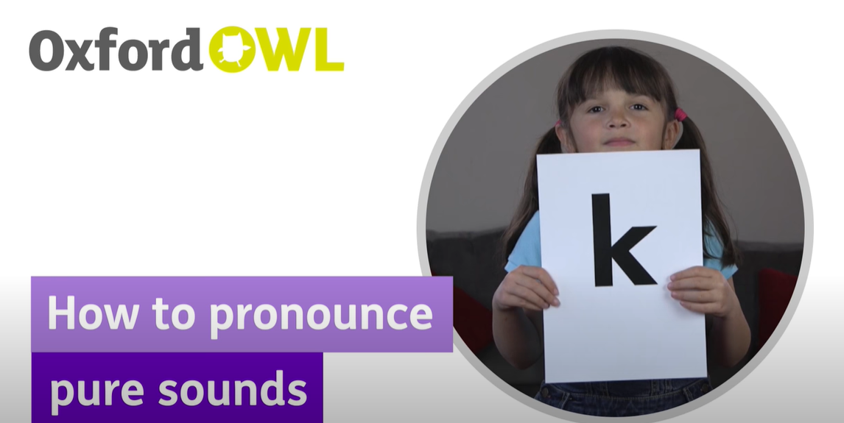

Slide 14

Questions

