Slide 1
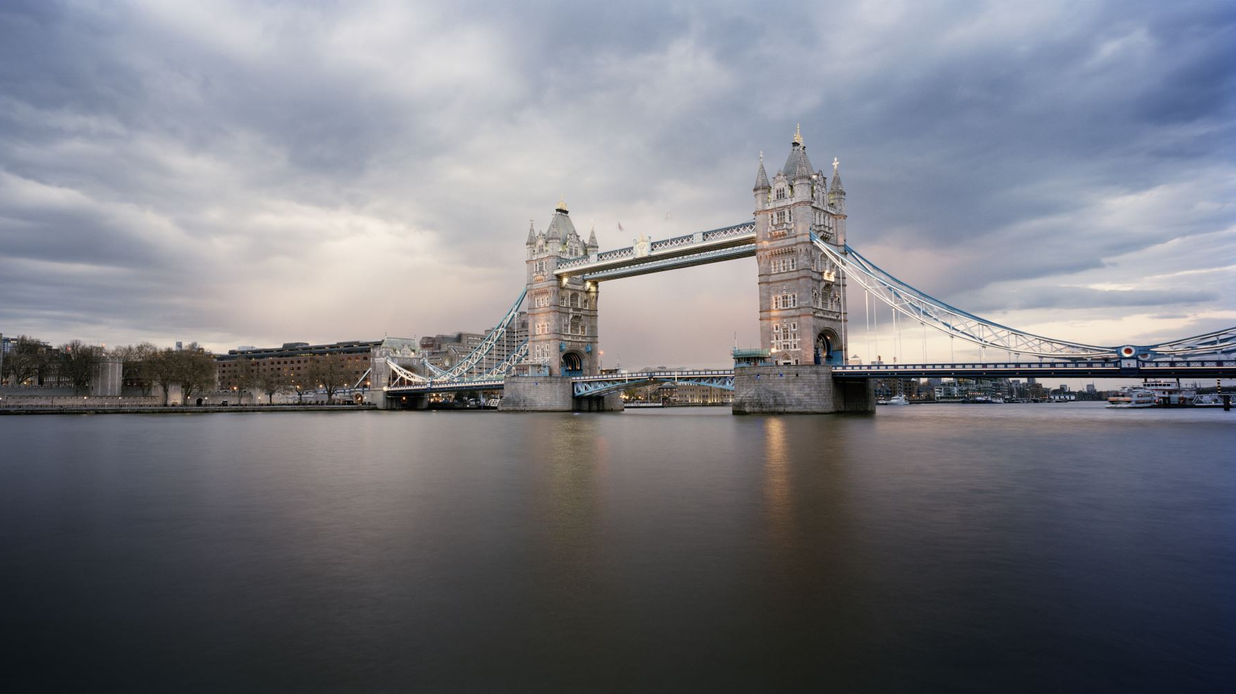
LONDON 2024
Wednesday 12th June – Friday 14th June

Slide 2
Where are we staying?
We are staying at the Premier Inn Hotel, Edgware with bed and breakfast board. The hotel is situated North of London, with easy access to the city by private coach. The rooms will be located on the same corridor and staff will ‘bookend’ the rooms. Children will be organised into rooms of 2, 3 and 4. We will eat breakfast at the hotel and be provided packed lunches by The London Lunchbox Company. However, you will need a packed lunch for our first day (Wednesday). Our evening meals will be in restaurants (please see itinerary).
Wednesday 12th June – Friday 14th June

Slide 3
How will we travel around London?
Executive Transport is booked to take us from place to place around London as well as transporting us there and back. Our hotel is slightly out of the city centre so we will have a 30 minute drive in and out of the city each day and night. Whenever children are off the bus, they will all wear individual high visibility jackets and walk in assigned pairs with assigned groups to an adult. They will also wear a lanyard with a card with the school number and my contact details on it to make the public aware that we are a school group. When visiting museums, we will split into smaller groups with adults but otherwise will always stay as one group. As a group, we will follow each individual attraction’s rules and risk assessment.
Wednesday 12th June – Friday 14th June

Slide 4
Administration of Medicine
We request that every child attends the trip with calpol or other pain relief (as an emergency back-up), attached to this letter is a medical form to be completed. The medication is then sent in on the day of (day before is preferable!) the trip in a labelled bag along with the form. Please send in sachets rather than bottles for hygiene purposes. The registered first aiders will keep all medication for the duration of the trip. Obviously, those children on our medical register will have all the medication we hold in school already. We will administer as instructed on your medical form but will inform you via text. All unused medication will be returned back to you at the end of the trip.
Wednesday 12th June – Friday 14th June

Slide 5
How will we stay in touch?
Emails, website and Facebook! We will constantly upload photos to the Gallery page of our website and let you know what we’ve been up to each day via email.. Staff on the trip will be contactable at all times via email so do not hesitate to get in touch if you have any worries or concerns, big or small! Ms Simmonds
Is listed as emergency school contact for out of hours as well. Children must NOT bring phones or any other technology with them on the trip – they will be far too busy!
tpartridge@redhill.worcs.sch.uk or ehallam@redhill.worcs.sch.uk
Wednesday 12th June – Friday 14th June

Slide 6
Things children can bring..
Children can bring up to £30 spending money to spend only on souvenirs throughout the trip. They need to remember to manage their money and not spend it all at once! They may bring sweets for the journey and to eat at the theatre. They may also like to bring a disposable camera (although we will take lots on the ipads and share these with you.
Wednesday 12th June – Friday 11th June

Slide 7
Itinerary!
WEDNESDAY
08:30 - Meet at school, load luggage ready for departure.
9:00 - Depart from school via coach provided by NST.
1:00 - Lunch (please provide your child with lunch for this day, preferable in a disposable bag that can be binned)
13:30 - Arrival in London at the Hotel
15:00 – Arrive Science museum
17:30 – Arrive at the Hard Rock Café for our evening meal
20:00 - Arrival at Premier Inn Edgware
21:00 - Settle into rooms 21:30 - BED!
Wednesday 12th June – Friday 14th June

Slide 8
Itinerary!
Smart wear
THURSDAY
07:00 - Continental breakfast will be served at the hotel. Packed lunches will be provided for the day
08:00 - Group to board coach and depart for Central London
10:00 - Arrive for a Guided Tour of the Shakespeare’s Globe Theatre
12:00 - Tour ends board coach and depart for Jubilee Park and Gardens
12:30 - Group to eat packed lunches by the London Eye
13:30 - Flight on the London Eye
14:30 - Arrive for a self-guided visit of Natural History Museum
16:30 - Group to board coach and depart for evening meal
16:45 - Get changed for theatre (clothes will need to be packed in a bag before leaving the hotel in the morning)
17:00 - Evening meal at Pizza Hut Leicester Square
18:00 - Group to proceed on foot to the Cambridge Theatre.
19:00 - Evening performance of The Lion King 19:30 - Performance commences
21:35 - Performance ends. Group to board coach and depart for the hotel.
22:45 - Anticipated arrival at the hotel. Straight to bed!
Wednesday 12th June – Friday 14th June

Slide 9
Itinerary!
FRIDAY
07:00 - Continental breakfast will be served at the hotel. Packed lunches will be provided for the day.
08:00 - Group to vacate their rooms and check out.
08:30 - Group to board coach and depart for the Imperial War Museum
10:00 - Arrive for a self-guided visit to the Imperial War Museum.
13:00 - Lunch in the grounds of Imperial War Museum
14:00 - Group to return to coach and prepare to depart London.
14:30 - Depart on coach to head back to school with stops along the way.
18:30 - Estimated arrival back at school – we will keep in touch via text message.
Wednesday 12th June – Friday 14th June

Slide 10
Kit List
Wednesday 12th June – Friday 14th June

Slide 11
Questions?
Wednesday 12th June – Friday 14th June

